Slide 1
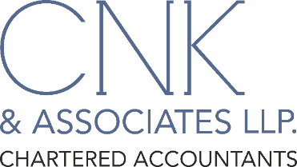
May 18, 2022
Opportunities in Internal Audit
www.cnkindia.com

Slide 3
What is Internal Audit ???
Internal auditing is an independent, objective assurance and consulting activity designed to add value and improve an organization’s operations. It helps an organization accomplish its objectives by bringing a systematic, disciplined approach to evaluate and improve effectiveness of risk management, control & governance processes.
Source: international professional practices framework (IPPF), the institute of internal auditors research foundation. Florida, USA, January 2011, 2013, 2017.

Slide 4
Objectives of Internal Audit
Compliances –
External & Internal
Governance Processes & Ethical Practices
Add Value, Help Achieve Objectives
Optimization of Resources, Costs & Processes
Risks & Controls

Slide 5
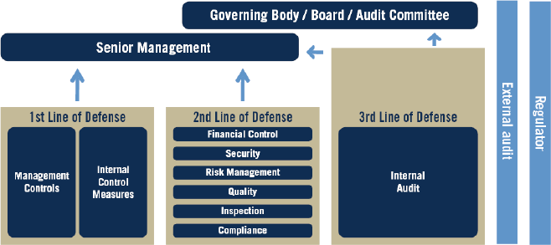
Three Lines of Defense

Slide 6
Regulatory Developments Conducive to IA Growth
Section 138 - Mandatory Internal Audit
Section 139 - Rotation of Statutory Auditors
Section 144 - Statutory Auditors not to be Internal Auditors for related entities
atory
IFC and ICFR responsibilities on Boards and Auditors
SEBI directions for Listed Companies for IA and Risk Management
CARO, 2020 with the inclusion of clause has restored the IA function and role to a certain pedestal
RBI – Risk based Audit
ds
di

Slide 7
IA Structures
In-House
Out-sourced
Co-Sourced
Mandatory Out-sourced
atory
ds
di

Slide 8
Internal Audit – Sectors Coverage
Banking
Financial Services
Insurance
Not for Profit
Manufacturing
Pharma / Health Care
Hospitality/ Entertainment
Real Estate
Travel & Logistics
IT & Software

Slide 9
Opportunities in IA
Risk Based IA
Perform Risk based Internal Audits across sectors
ERM/ RCM Framework
Identifying the risks and create the ERM/ RCM framework, connecting the strategic Business Plan
ICFR Control Testing
Design & implementation of Internal Financial Controls (IFC)
Execute multi year Internal Audit Plans for entities basis Risk framework
Develop a Risk Dashboard for periodic reporting
Testing effectiveness of ICFR
Preparing Risk Registers
Preparing Risk Control Matrix – identifying risks and associated controls

Slide 10
Opportunities in IA
Process Re-engineering
Data Analytics
Help in developing macros / designing and implementation of data analytic capabilities / data trending
Develop Scripts for identifying Red Flags in areas like Procure to Pay, Order to Cash, Hire-to-Retire
Identify red flags in Account Opening, Vendor Onboarding, Duplicate Vendor Payments, Benami Transactions
Use of IDEA, Advance Excel, Power BI tools
End-to-end Process Audits of functions/ departments
Profitability review and cost optimization studies
Conduct in-depth process reviews to recommend best practices & process improvements inside/ outside systems
SOP Drafting
Assist in documenting the procedures in existence
Strengthen the existing procedures by suggesting enhancements & improvements
Recommend suitable MIS formats keeping KPIs in mind

Slide 11
Opportunities in IA
Concurrent Review / Audit
Concurrent audit for specialized function like Treasury, Trade Finance, centralized operations and large credit portfolios (RBI Requirement)
Forensics Audits/ Review
Frauds committed by Employees / External party
Investment operations as per IRDA regulation for Life and General Insurance
Embezzlement of Cash / Jewellery
Cyber Frauds
Frauds Committed by Borrowers (Empanelment with IBA/ Banks)
Quality Assurance
Quality assurance for Mutual Funds: independent calculation/ pre confirmation of NAV, limits, redemptions, reporting to the Boards etc.

Slide 12
Opportunities in IA
Systems Review/ Audit
GAP analysis based on ISO 27001
AIF Review
Risk based process reviews to evaluate and improve the effectiveness of Risk Management, Control and Governance Processes
Regulatory Compliances
FEMA compliance for trade functions
Systems Audit covering Logical access, System interfaces & Application/ network Securities, VAPT tests, Log reports & System Monitoring, Change management & version controls & BCP/ DRO procedures
Confirmation on the accuracy and logics used for computation of the Management fees
Review of Net Asset Value (NAV) before publishing to the Investors.
Quarterly compliance audit for PMS activity
Half yearly compliance of Equity/Commodity /Rating Agency companies
PPM / Compliance audit for AIF Entities
RBI – NBFC IT Audit
SEBI – Cyber Security Audit for Broking Members
IRDA – Systems Audit for Insurance Companies
Compliance review of Prohibition of Insider Trading Regulation

Slide 13
Opportunities in IA
CSR Review
CSR implementation Support
Advisory
Designing and implementation of paperless office including implementation of workflows for cross functional processes
Investment Control Review
Control review of Investment operations for Banks/ Insurance/ Mutual Funds Treasury
Design and implementation of internal controls, advisory of cost optimization, IT access and controls
Process improvements/ best practices
Conduct high-level management review, legal & compliance review, & operational review of processes of NGO partners
Compliance audit
Due diligence of the NGO prior to making CSR commitment if third party NGO mode is selected
Conduct impact analysis
Documentation of policies and processes

Slide 14
Opportunities in IA
Hospital & Hospitality Audits
Concurrent audit of In-Patient/ Room occupancy billing identifying the revenue leakage
Internal audit covering Cash handling & banking, Procurement, compliance review related to hospitals, People Management, Capital Assets, F&B revenue etc.
Other Areas
Vendor Audits
Depot/ Branch Audits
Mystery Shopping

Slide 15
Need for Specialization
Bypass Basics: New Plumbing for the Heart
Written by:
Christine Haran -
Published on: September 29, 2004
What is coronary bypass surgery?
In bypass surgery, we use either arteries or veins from the patient's own body to create a bypass around blockage in the artery, so blood can flow beyond the blockage to the heart muscle that's being supplied by that artery. It's like new plumbing. We're creating a new avenue for blood to go to the heart muscle.
It is established that the bypass surgery is basically a plumbing job –
would you allow your plumber to do your bypass?
3

Slide 16
Qualification / Skill sets required
Chartered Accountants (CAs)
Forensic Accounting & Fraud Detection (FAFD)
Diploma in Information Systems (DISA)
Certified Internal Auditor (CIA)
Certified Information Systems Auditor (CISA)
Engineers

Slide 17
Association / Empanelment
Membership of ICAI/ IIA/ ISACA
Joining Study Groups
Empanelment with SEBI/ IBA / AMFI/ SFIO
RFPs - https://www.pdicai.org/Opportunities.aspx

Slide 18
Thank You

